Slide 1
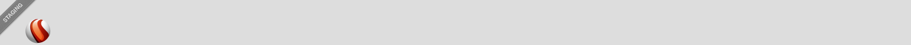

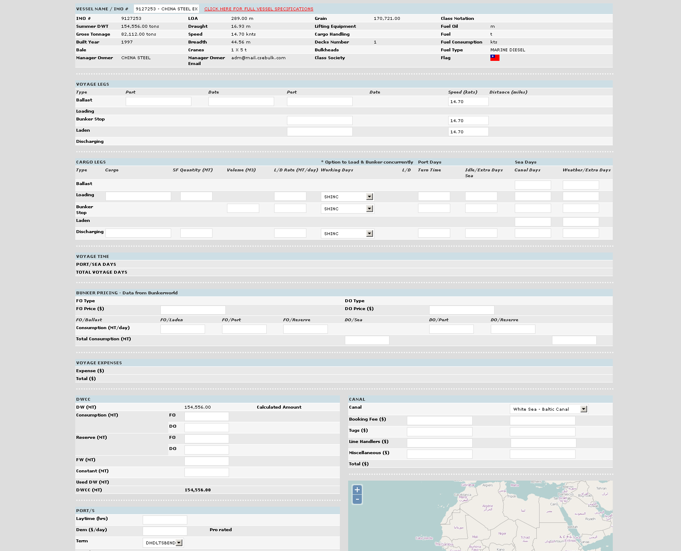
Voyage Estimation
Voyage Estimator
Distance Tables
Ports Intelligence
Piracy Notices
Bunker Pricing
Weather

